Slide 1
History Of Programming Languages
Prepared by: Jordan R. Kharkrang

Slide 2
A brief history of programming languages
Since 1940: Thousands of Programming Languages have been created.
However Only a few Languages remain handful and are widely used.
Eg: C, C++,JAVA,PHP,Ruby

Slide 3
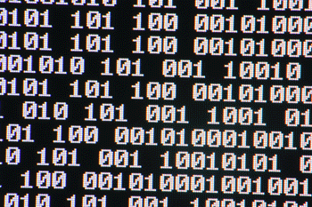
A brief history of programming languages
Machine Language
Speaks directly to the CPU.
Extremely difficult to understand.
Therefore, other languages were created that would convert into machine languages.

Slide 4
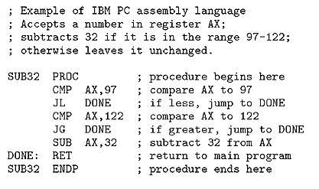
A brief history of programming languages
Assembly Languages
Slightly more readable, but still not very clear.

Slide 5
A brief history of programming languages
High Level Languages
It is more similar to the English Language.
A Compiler is a program that converts the English-Like written codes to numbers and letters that a computer understands.

Slide 6
A brief history of programming languages
FORTRAN:
Created in 1957, stands for Formula Translating System.
Designed for Scientific Computing.
ALGOL:
Created in 1958, stands for ALGOrithmic Language.
Designed for Scientific Calculations.
LISP:
Created in 1958.
Designed for Artificial Intelligence(AI) research.

Slide 7
A brief history of programming languages
COBOL:
Created in 1959, stands for Common Business Oriented Language.
Designed for Business Computing.
PASCAL:
Created in 1968..
Designed for good programming practices , structured programming and data structures .

Slide 8
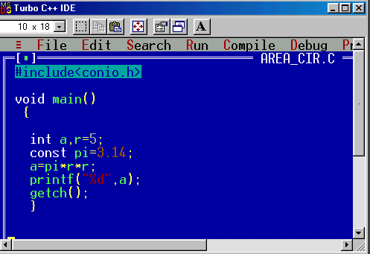
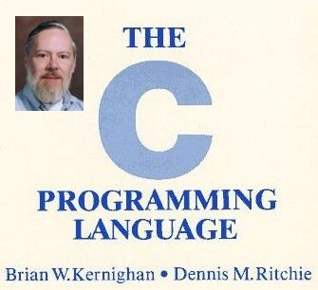
A brief history of programming languages
C language

Slide 9
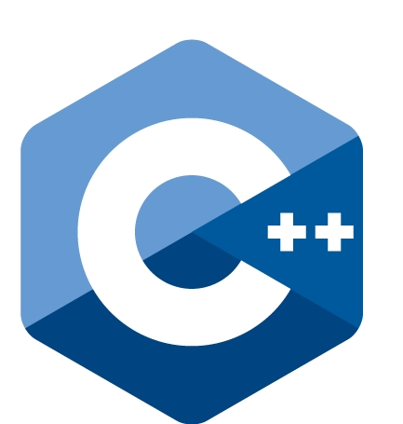
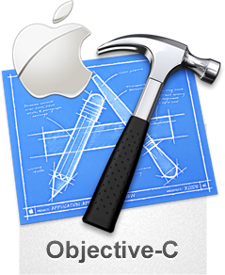
A brief history of programming languages
C++
Microsoft Windows was mostly built using C++
Objective-C
MAC OSX and iOS was built using Objective C

Slide 10
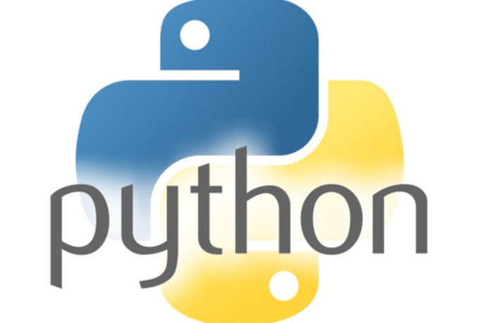
A brief history of programming languages
Created in 1989
General purposed programming languages; created with the intention of being very readable.
YouTube was built using Python

Slide 11
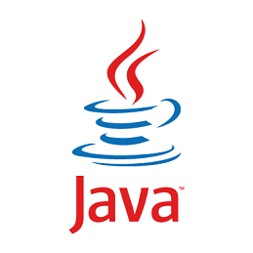
A brief history of programming languages
Created in 1995 by Sun Microsystems.
General purpose language; created with the intention of being run in many different platforms.
Android built using Java.

Slide 12

A brief history of programming languages
Created in 1993 in Japan.
Created with the intention of helping programmers to accomplish more with less code.
Twitter built using Ruby.

Slide 13
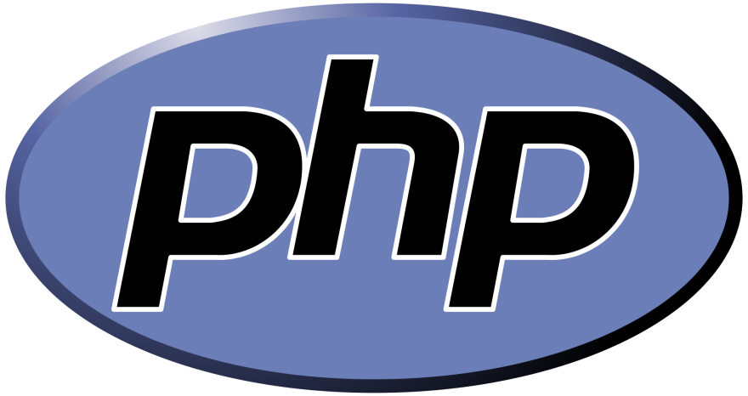
A brief history of programming languages
Created in 1995
Designed to be for Web development.
Over 200million websites are created using PHP.
Mark Zuckerburg used PHP to built Facebook in 2004.

Slide 14
THANK YOU

